Slide 1

Sampling Distribution and Central Limit Theorem
Tanveer Ahmed

Slide 2
Sampling Distributions
Population parameter: a numerical descriptive measure of a population.
Examples: m = mean height of all Bennett students
Sample statistic: a numerical descriptive measure calculated from sample data.

Slide 3
Parameters: Statistics
In real life parameters of populations are unknown and unknowable.
For example, the mean height of Indian adults (18+) is unknown and unknowable
Rather than investigating the whole population, we take a sample, calculate a statistic related to the parameter of interest, and make an inference.
The sampling distribution of the statistic tells us how the value of the statistic varies from sample to sample.

Slide 4
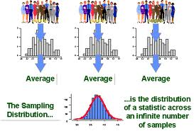
DEFINITION: Sampling Distribution
The sampling distribution of a sample statistic calculated from a sample of n measurements is the probability distribution of values taken by the statistic in all possible samples of size n taken from the same population.
Based on all possible samples of size n.

Slide 5
Population Parameter of Frequent Interest: the Population Mean µ
To estimate the unknown value of µ, the sample mean x̅ is often used.
We need to examine the Sampling Distribution of the Sample Mean x̅
(the probability distribution of all possible values of x based on a sample of size n).

Slide 6
Sampling Distribution of the Sample Mean x̅: Example
An example
A fair 6-sided die is thrown; let X represent the number that shows up
The probability distribution of X is
x 1 2 3 4 5 6
p(x) 1/6 1/6 1/6 1/6 1/6 1/6
Population mean μ:
μ = E(X) = 1(1/6) +2(1/6) + 3(1/6) +……… = 3.5.
Population variance σ²
σ² =V(X) = (1-3.5)²(1/6)+
(2-3.5)²(1/6)+ ………
………. = 2.92

Slide 7
Suppose we want to estimate μ from the mean x̅ of a sample of size n = 2.
What is the sampling distribution of x̅ in this situation?

Slide 8
6/36
5/36
4/36
3/36
2/36
1/36
E( ) =1.0(1/36)+
1.5(2/36)+….=3.5
V(X) = (1.0-3.5)²(1/36)+
(1.5-3.5)²(2/36)... = 1.46
1 1.5 2.0 2.5 3.0 3.5 4.0 4.5 5.0 5.5 6.0

Slide 9
1
6
1
6
Notice that is smaller
than Var(X). The larger the sample
size the smaller is . Therefore,
tends to fall closer to μ, as the
sample size increases.
1
6

Slide 10
The variance of the sample mean is smaller than the variance of the population.
Mean = 1.5
Mean = 2.
Mean = 2.5
Population
1
1.5
2
2.5
1.5
2
2.5
3
1.5
2
2
2.5
1.5
2
2.5
1.5
2
2.5
Compare the variability of the population
to the variability of the sample mean.
Let us take samples
of two observations
1.5
2.5
1.5
2
2.5
1.5
2
2.5
1.5
2
2.5
1.5
2.5
1.5
2
2.5
1.5
2
2.5
1.5
2
2.5
Also,
Expected value of the population = (1 + 2 + 3)/3 = 2
Expected value of the sample mean = (1.5 + 2 + 2.5)/3 = 2

Slide 11
Properties of the Sampling Distribution of x

Slide 12
What can we do now?
We know 2 parameters of the sampling distribution of x :

Slide 13
THE CENTRAL LIMIT THEOREM
The “World is Normal” Theorem

Slide 14
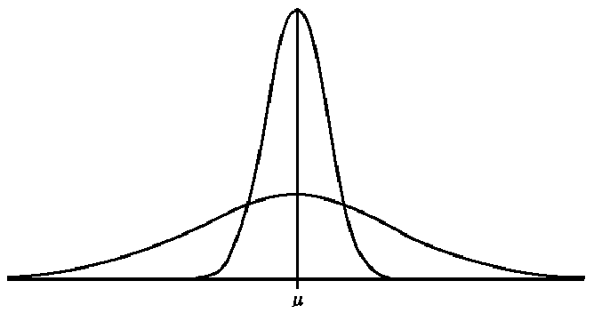
But first,…Sampling Distribution of Normally Distributed Population
Sampling distribution of x:
N(μ , σ /√10)
n=10
σ/√10
Population distribution:
N(μ , σ)
σ

Slide 15
Normal Populations
Important Fact: If the population is normally distributed, then the sampling distribution of x is normally distributed for any sample size n.

Slide 16
Non-normal Populations
What can we say about the shape of the sampling distribution of x̅ when the population from which the sample is selected is not normal?

Slide 17
The Central Limit Theorem (for the sample mean x̅)
If a random sample of n observations is selected from a population (any population), then when n is sufficiently large, the sampling distribution of x̅ will be approximately normal.
The larger the sample size, the better will be the normal approximation to the sampling distribution of x̅.

Slide 18
The Importance of the Central Limit Theorem
When we select simple random samples of size n, the sample means x̅ will vary from sample to sample. We can model the distribution of these sample means with a probability model that is …

Slide 19
How Large Should n Be?
For the purpose of applying the Central Limit Theorem, we will consider a sample size to be large when n > 30.
←
←
←
Even if the population from which the sample is selected looks like this …
… the Central Limit Theorem tells us that a good model for the sampling distribution of the sample mean x̅ is …
→
→
→

Slide 20
Summary
Population: mean μ; stand dev. σ; shape of population dist. is unknown; value of μ is unknown; select random sample of size n;
Sampling distribution of x:
mean μ; stand. dev. σ/√n;
always true!
By the Central Limit Theorem:
the shape of the sampling distribution is approx normal, that is
x̅ ~ N(μ, σ/√n)

